Slide 1

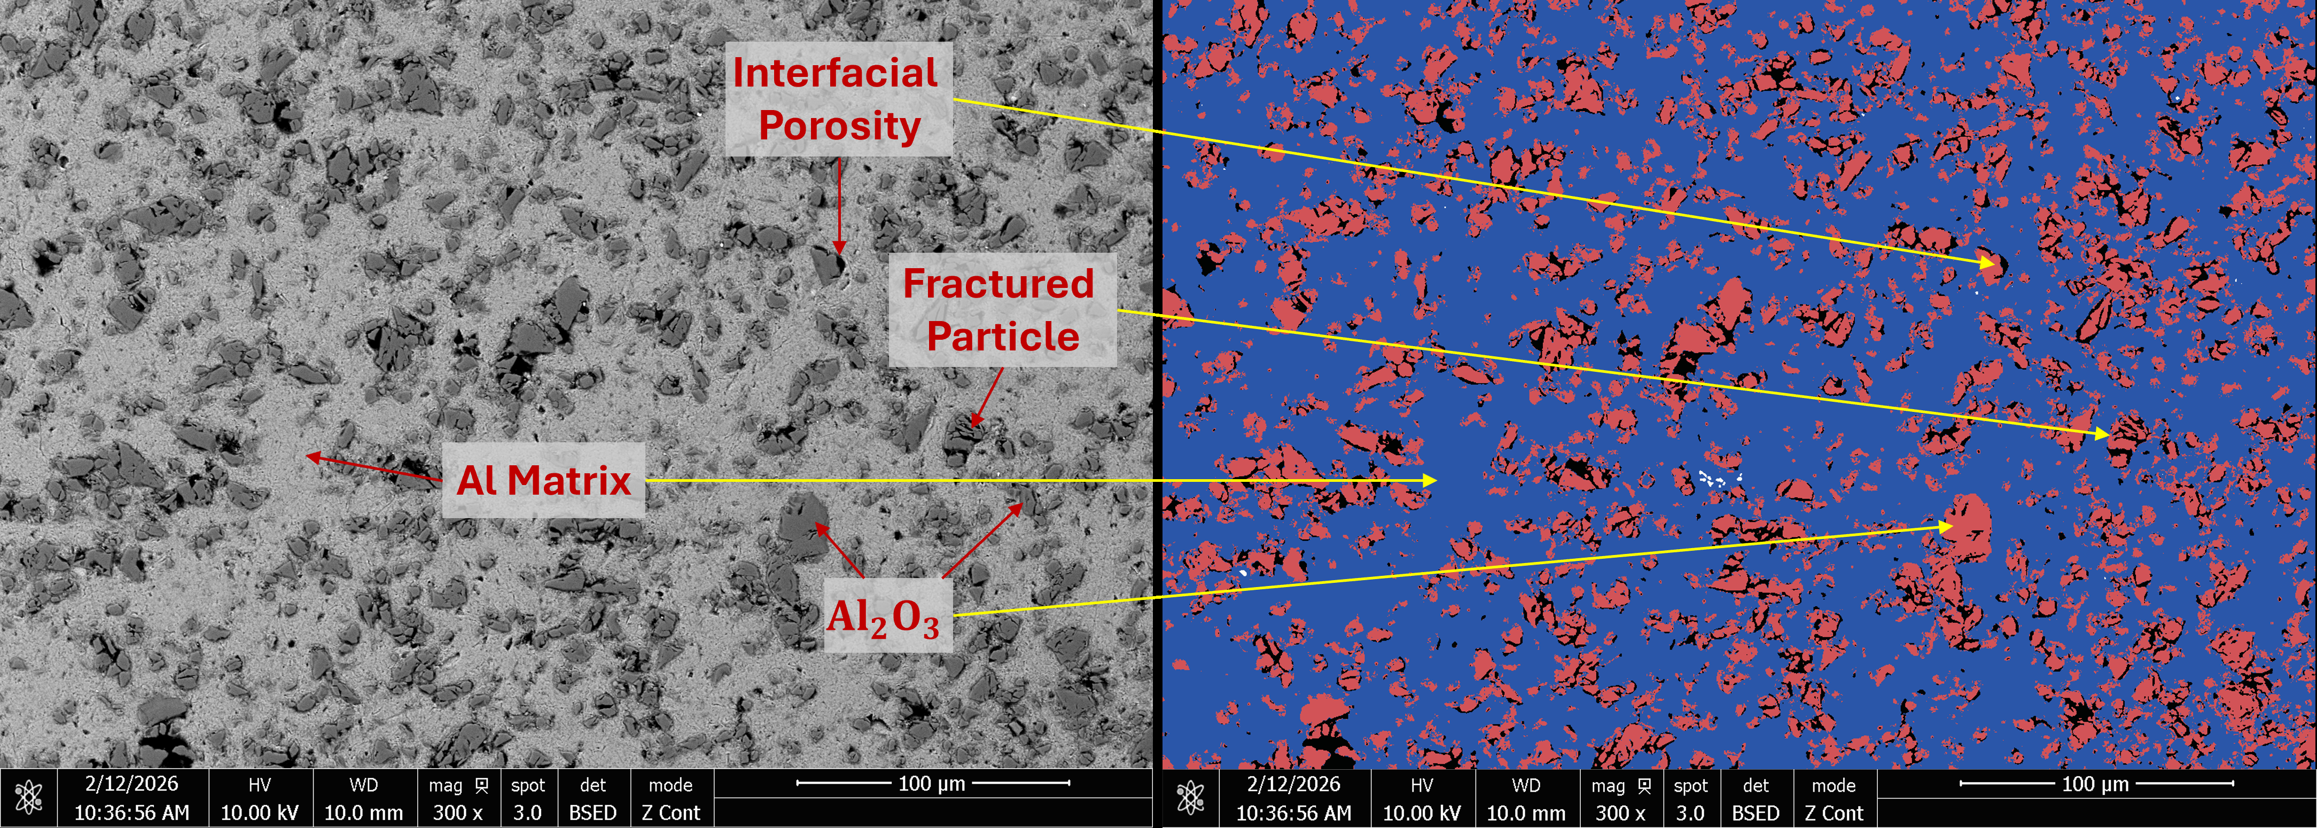
MATERIALS AND SURFACE ENGINEERING
DEPARTMENT OF CIVIL AND MECHANICAL ENGINEERING
PROJECT LEVEL: MASTER'S THESIS
Powder design for cold-sprayed
Al-Al₂O₃ coatings on aluminum substrate
SUPERVISORS
Lead Supervisor
Marcel A.J. Somers
DTU Construct
majs@dtu.dk
Co-supervisors
Basit Ali
DTU Construct
baali@dtu.dk
Louis Cavichiolo
Left: BSE cross-section of a coating deposited from an Al-60 wt.% Al₂O₃ powder blend.
Right: Corresponding image segmentation used to quantify the area fractions of the Al matrix, retained Al₂O₃ and porosity.
ReliBond
COLLABORATION
ReliBond ApS, Denmark
01 / PROJECT BACKGROUND
High-voltage cables transmit electricity in underground power networks, subsea links and connections to offshore wind farms. Since cables are manufactured and installed in sections, their conductors must be joined to maintain reliable electrical and mechanical continuity. Welding can create these connections, but its heat input can damage nearby insulation and complicate on-site installation. Cold spraying offers a way to form metallic contact layers without melting the powder. Relibond ApS, Denmark develops cold-sprayed aluminum coatings for high-voltage cable joints. Alumina in the feedstock assists surface activation, but excessive retention and unstable powder delivery can limit coating quality .
02 / PROJECT AIM
Establish how alumina content in the powder feedstock influences coating formation, microstructure and adhesion on aluminum conductors. Identify a suitable blend that combines reliable feeding and stable nozzle operation with strong bonding and low retained alumina. Support this recommendation through validated measurements of blend composition and homogeneity, together with repeat coating experiments.
03 / PROJECT ACTIVITIES
Prepare Al-Al₂O₃ powder blends with varying alumina contents, with limited particle-size comparisons where feasible.
Develop and validate a method to verify blend homogeneity and the powder composition delivered by the feeder.
Produce coatings under controlled cold-spray conditions and evaluate deposition efficiency, coating build-up and nozzle operability.
Use SEM/EDS, image analysis and pull-off testing to assess retained alumina, porosity and adhesion. Compare promising blends with the reference through repeat experiments.
04 / PRACTICAL NOTES
Cold-spray experiments will take place at ReliBond, with microscopy, XRD and mechanical testing at DTU. Electrical testing is outside the scope of the proposed project. The experimental plan may be refined based on initial findings and powder availability.
DTU CONSTRUCT / MATERIALS AND SURFACE ENGINEERING

Slide 2
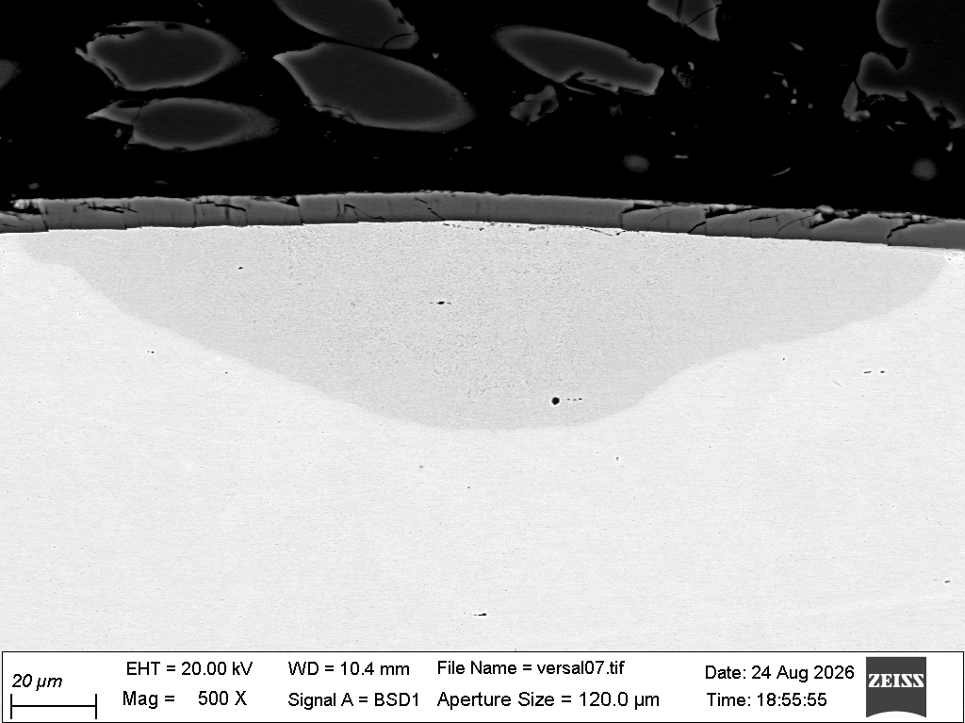
MATERIALS AND SURFACE ENGINEERING
DEPARTMENT OF CIVIL AND MECHANICAL ENGINEERING
PROJECT LEVEL: MASTER OR BACHELOR
Protecting steels against
high-temperature ammonia corrosion
Magnetron-sputtered
TiAlSiN coating
SUPERVISORS
Lead Supervisor
Marcel A.J. Somers
DTU Construct
majs@dtu.dk
Co-supervisor
Localized nitrided region
due to ammonia attack
Basit Ali
310 stainless steel
DTU Construct
baali@dtu.dk
COLLABORATION
Cross-sectional BSE-SEM image showing localized substrate attack beneath a PVD coating after NH₃ exposure.
Danish Technological
Institute (DTI)
01 / PROJECT BACKGROUND
Ammonia is a promising carbon-free fuel and hydrogen carrier, but hot ammonia can cause nitridation and embrittlement of steels used in heat exchangers, crackers and fuel systems. Magnetron-sputtered coatings offer a possible barrier, yet local defects may allow severe attack beneath the coating. In collaboration with the Danish Technological Institute (DTI), this project investigates coating protection and failure in stainless steels.
02 / PROJECT AIM
Relate coating composition, thickness and defects to local ammonia attack, and identify promising protective systems under the tested conditions. Compare selected metallic and nitride coatings with uncoated references using specimens from existing and new exposure campaigns.
03 / PROJECT ACTIVITIES
Perform selected exposure experiments in dry and wet ammonia at controlled temperatures and gas flows
Examine coating surfaces and polished cross-sections using light optical microscopy and SEM/EDS.
Use XRD to identify crystalline phases and changes associated with ammonia exposure.
Quantify attack depth, affected fraction and coating damage, then relate these to mass change and coating structure.
04 / PRACTICAL NOTES
DTI will supply coated specimens. Exposure experiments and characterization will take place at DTU, with training in the relevant methods provided. The scope will adapt to specimen availability, initial findings and the project duration.
DTU CONSTRUCT / MATERIALS AND SURFACE ENGINEERING

Slide 3
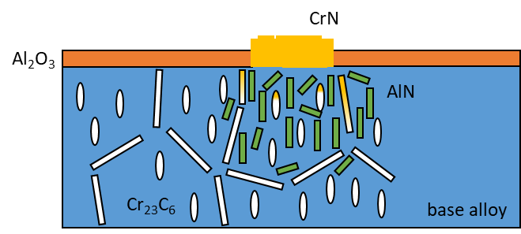
MATERIALS AND SURFACE ENGINEERING
DEPARTMENT OF CIVIL AND MECHANICAL ENGINEERING
PROJECT LEVEL: MASTER OR BACHELOR
Aluminium diffusion layers for mitigation of nitridation corrosion in ammonia cracking equipment
SUPERVISORS
Marcel A.J. Somers
majs@dtu.dk
Basit Ali
[INSERT PROJECT IMAGE]
baali@dtu.d
COLLABORATION
Materials & Corrosion-KnowHow (NL)
Chromin Maastricht (NL)
Schematic nitridation of a cast Fe-Cr-Al alloy (from Aymans, et al. Materials & Corrosion, 2026)
01 / PROJECT BACKGROUND
At elevated temperatures, ammonia dissociates at metallic surfaces and provides a high nitrogen activity at the metal surface, potentially resulting in nitridation corrosion. The project investigates the suitability of an aluminium diffusion layer against nitridation under conditions relevant to the ammonia heating section of an ammonia cracking installation.
02 / PROJECT AIM
The main objective of the project is to experimentally determine the effectiveness of an aluminium diffusion layer in preventing or minimizing nitridation of selected engineering materials exposed to ammonia-containing environments at approximately 250–550 °C. The investigation should provide a technical basis for assessing whether aluminium diffusion treatment is a feasible mitigation for components in the heating section of the ammonia cracking service.
03 / PROJECT ACTIVITIES
exposure of industrially provided coated and uncoated materials to ammonia in thermobalance and stationary furnace
characterization of the resulting microstructure with microscopy, diffraction and spectroscopy techniques
assessment of effectictiveness of alumina coatings and potential limitations
04 / PRACTICAL NOTES
You will be involved in the exposure and characterization with LOM, SEM, XRD and EDS of several alloys for relatively low T nitridiation effects and determine in which temperature ranges these alloys are safe to use.
DTU CONSTRUCT / MATERIALS AND SURFACE ENGINEERING

